Slide 1
Early Reading & Phonics Workshop

Slide 2
What we will cover today:
The importance of nursery rhymes & well known favourites
The importance of wordless picture books and storytelling
What is phonics?
Home-School reading partnership

Slide 3
Nursery Rhymes
Nursery rhymes are short & easy to repeat.
As children recite nursery rhymes, they learn new words and how to pronounce them.
Nursery rhymes provide an early introduction to phonics (the ability to hear, identify and manipulate letter sounds).
They develop rhythm, rhyming patterns, repetition and alliteration to make them fun and easy to remember.

Slide 4
Nursery Rhymes
Short nursery rhymes often tell a story with a beginning, middle and end.
It helps children to follow a sequence of events, a skill they need when reading and writing.
Nursery rhymes are an early form of poetry and they introduce children to the rules and patterns.
Children who know eight or more nursery rhymes by the age of four improve their reading and spelling.

Slide 5
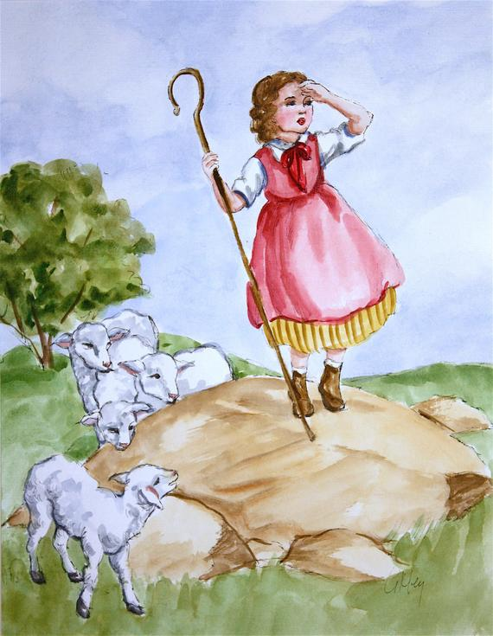
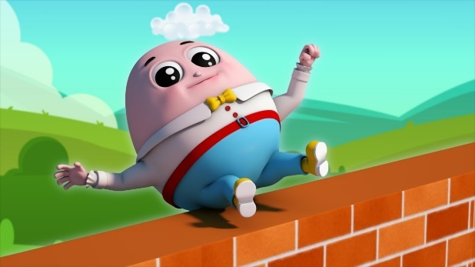
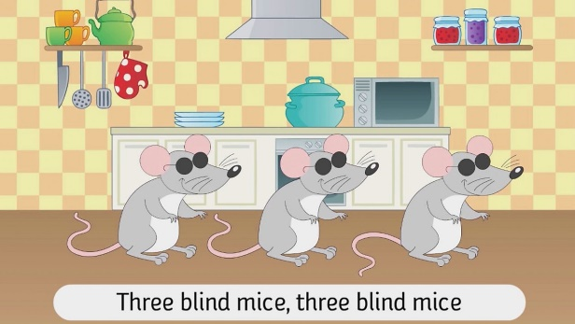
See the handout for popular nursery rhymes & games to sing and play with your child at home.

Slide 6
Wordless Picture Books
Wordless picture books are told entirely through their pictures.
They offer opportunities for language-rich conversations with young children.
Wordless books reinforce the idea that the story and pictures are connected.

Slide 7
Wordless Picture Books
They develop children’s storytelling skills and encourage their imagination to grow.
Storytelling skills can be modelled to the children, with a suggestion of different story ideas.

Slide 8
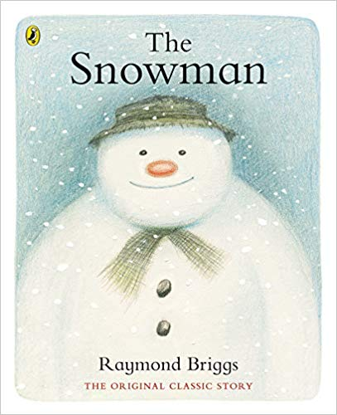
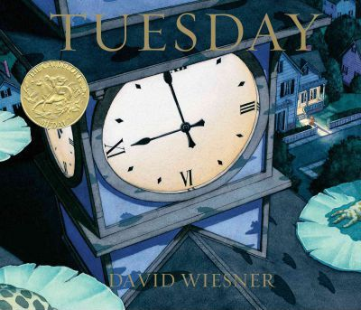
See the handout for some of the best wordless picture books to share with young children.

Slide 9
What is phonics?
Children are taught to read by breaking words down into separate sounds (phonemes).
They are taught to read by blending sounds together to read the whole word.
There are around 40 different sounds that children will learn over time.

Slide 10
What is phonics?
Phoneme: A sound made up of a letter or group of letters.
Digraph: Two letters making one sound e.g. ‘ow’ in ‘cow’.
Trigraph: Three letters making one sound e.g. ‘igh’ in ‘light’.
Split Digraphs: Two vowels making one sound with a consonant in between e.g. ‘i_e’ in ‘bike’.

Slide 11
What is phonics?
Phase 1 is key to giving children a solid foundation for learning phonics. It includes:
Sound discrimination e.g. environmental sounds, instrumental sounds & body percussion.
Rhythm & rhyme.
Alliteration & playing with words e.g. sizzling sausages.

Slide 12
What is phonics?
Voice sounds e.g. weeeee, drip drop.
Oral segmenting & blending e.g. b-b-b-ball, get your c-oa-t coat.
Children in Nursery will focus on phase 1 and giving children these early experiences.

Slide 13
The sounds are then taught across phases 2-5 from Reception to Year 2.
See the handout for the order of sounds across the phases.

Slide 14
What is phonics?
Children also learn to read tricky words that cannot be broken down (segmented).
These are grouped into words across the phases and taught explicitly.
Children are also taught common exception words in both years 1 & 2.

Slide 15
See the handout for the tricky & common exception words.

Slide 16
Home-School Reading Partnership
Children take part in daily story times and are exposed to a wide range of texts.
Children from nursery to year 2 have weekly library sessions, allowing them to borrow books of interest.
Children in Reception read with their teacher on a weekly basis.

Slide 17
Home-School Reading Partnership
Children in Key Stage 1 take part in daily guided reading sessions, either in small groups or whole class.
They are exposed to texts beyond a level at which they can read independently.
Children also read 1:1 with their teacher on a regular basis.

Slide 18
Home-School Reading Partnership
Children in Reception and Key Stage 1 receive daily phonics teaching for both reading & spelling.
The learning is tailored to every child’s needs to allow them to make progress from their starting points.
Progress is carefully tracked and children receive interventions where appropriate.

Slide 19
Home-School Reading Partnership
All children have a reading diary and an individual reading book.
It is expected that all children read at home with an adult. This should be at least 5 times across a week.
Reading sessions at home only need to be short; 5 minutes is sufficient.
Children who read regularly at home make more progress in their reading.

Slide 20
Home-School Reading Partnership
Re-reading is important for fluency. Children should read a text more than once to develop their confidence.
Comprehension is as important as word reading. Children should understand what they have read.
Above all, reading should be a fun and enjoyable experience!

Slide 21
See the handout for key questions to ask during reading.

Slide 22
Any questions?

